Slide 1
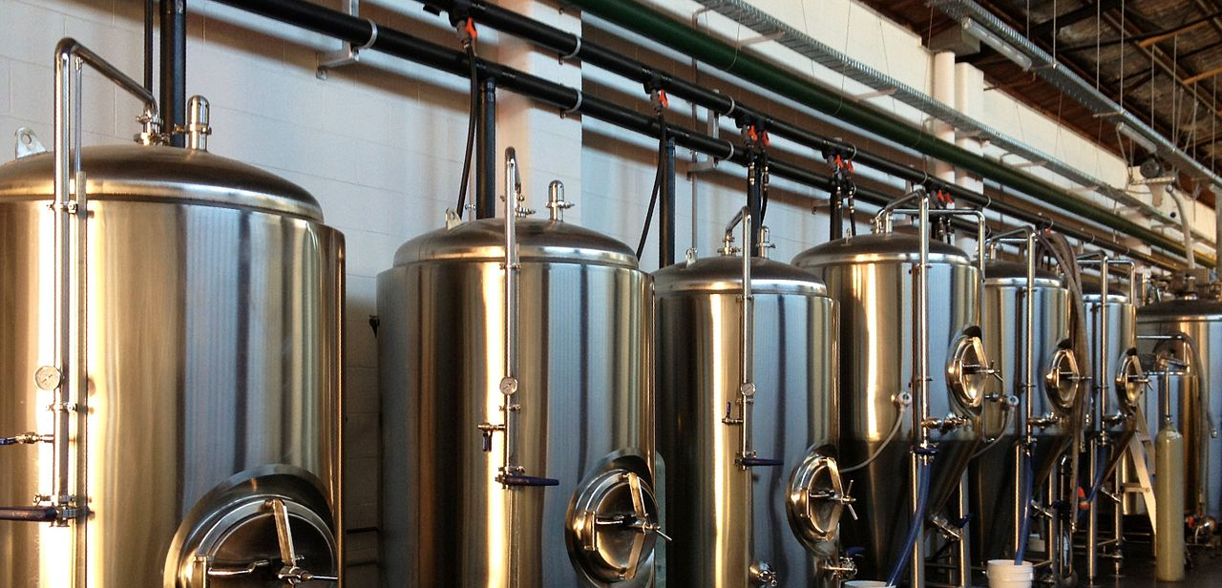

Brewpedia
This Photo by Unknown Author is licensed under CC BY-SA
Ashish Desai
Bejirose K. Stanly
Poonam Kushwaha
Renee Gillmore

Slide 2
Hypothesis
Expect IPA to be the most consumed style globally due to the high Alcohol By Volume (ABV) and International Bitterness Unit (IBU)
For this we did:
Find brewery counts by country, state, city
Find top beer type for each country
Amount of beer brewed by state vs number of breweries

Slide 3
Source List
Ashish
https://maps.googleapis.com/maps/api/geocode/json
https://googles.p.rapidapi.com/breweries
https://api.openbrewerydb.org/breweries
https://www.kaggle.com/
Bejirose
https://maps.googleapis.com/maps/api/geocode/json
https://maps.googleapis.com/maps/api/place/nearbysearch/json
https://sandbox-api.brewerydb.com/v2/breweries
https://www.nbwa.org/resources/industry-fast-facts#:~:text=Based%20on%20beer%20shipment%20data,and%20considered%20legal%20drinking%20age.html
Poonam
https://maps.googleapis.com/maps/api/place/textsearch/json
Renee
https://maps.googleapis.com/maps/api/place/nearbysearch/json
https://www.kaggle.com/

Slide 4
Data Source - Limitations
Unable to get API Key (Untappd API, TripAdvisor API)
Limited API request calls (Beermapping API – dropped it)
Limited datasets (Google API, Rapid API)
Limited documentation (Rapid API)
Static data for data analysis in .csv format (Kaggle.com)
Paid membership required to BrewerAssociation.com for yearly data, actual production volumes of breweries
OpenBreweryDB – 25 results/page max but can iterate over index pages
Bad data

Slide 5
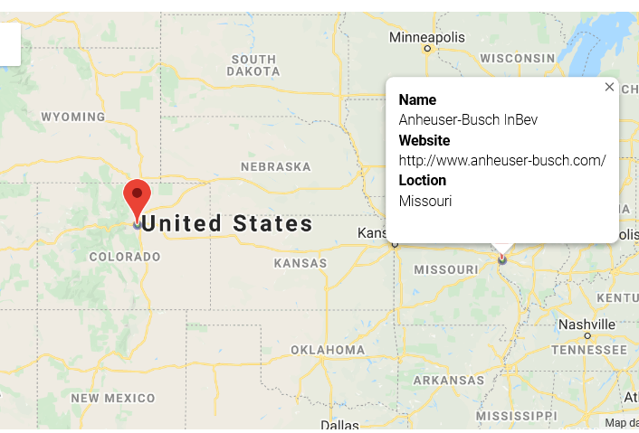
API Query to Mapping Process
Queried breweryDB API
Cleaned the data with no Latitude and Longitude
Marked using latitude and longitude
Heatmap on rating
Pinned on Brewery Name, Website, Location

Slide 6
Data Mangling
Common Issues faced:
NaN on Latitudes and Longitudes
Missing address
Missing City
Missing State
JSON fields expected would be missing
CSV data merge & cleaning
Solved by:
Looking for status = “OK” on JSON results
Used if..else or try..except
When OpenBreweryDB API did not have location info, used GoogleGeocode API to locate Lat, LNG with address, or city/state search.

Slide 7
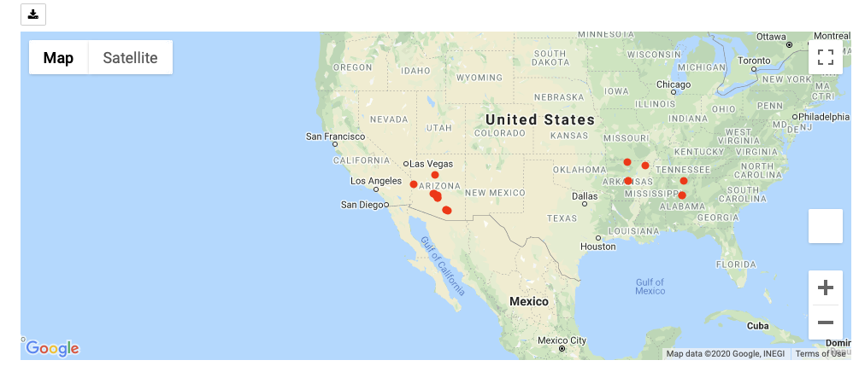
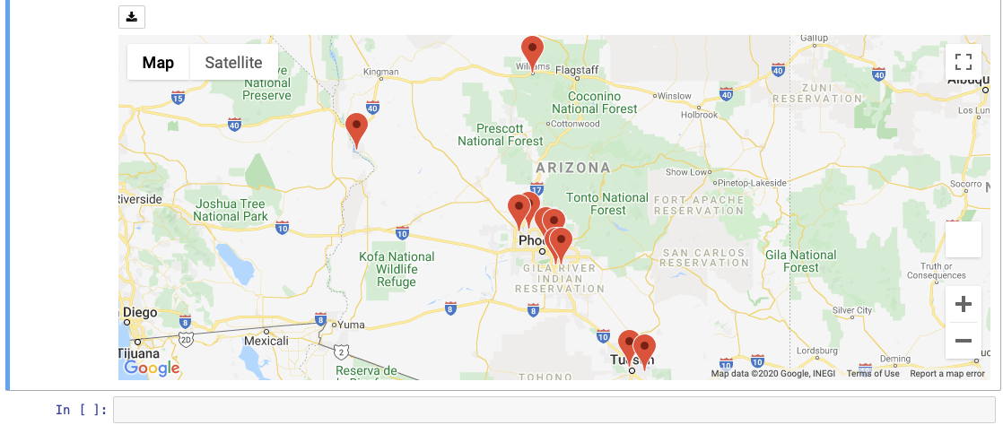
Jupyter GMAP Feature
Map type – terrain, satellite
Symbol layer
Marker Layer

Slide 8
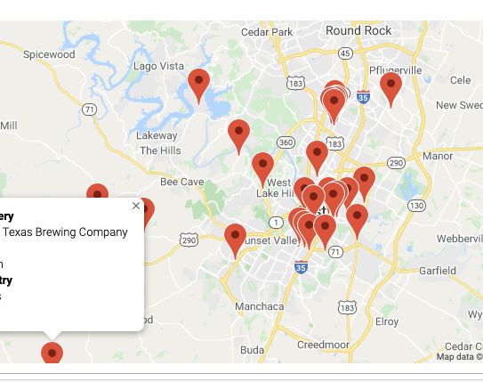
Jupyter GMAP Centering Challenge
Centering for map results display
Took average of Latitudes and Longitudes of results to plot and centered the map on the mean coordinates.

Slide 9
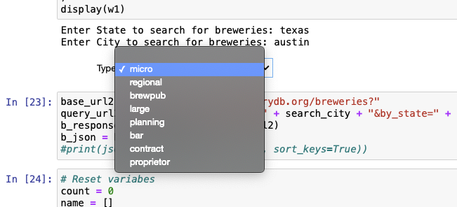
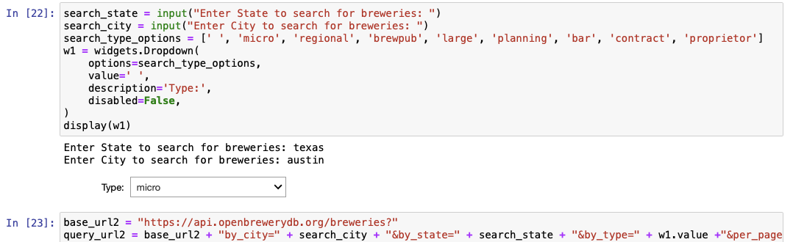
Jupyter Pandas WIDGETS
Drop-down menus
import ipywidgets as widgets

Slide 10
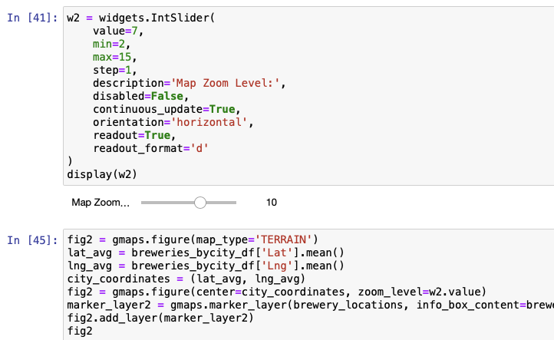
Jupyter Pandas WIDGETS [Cont’d]
Sliders for map zoom
import ipywidgets as widgets

Slide 11
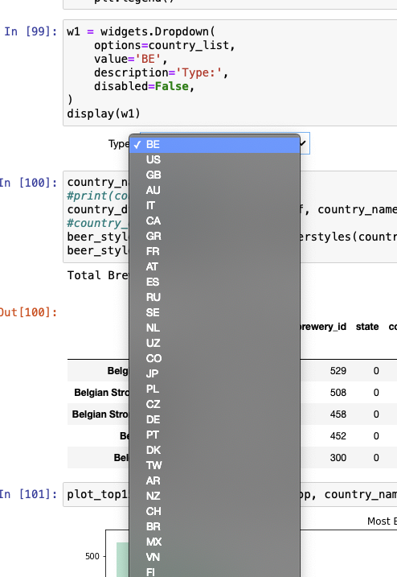
Jupyter Matplotlib
Retrieved country list from global breweries data and
Loaded them into a list for drop-down selection so we
Can run report on top brew style by country
Used functions to get top brew styles and plot for each country
American IPA was surprisingly most common in many countries
except in Germany and Belgium which makes sense given the
history in brewing.
What country would you like to look at?

Slide 12
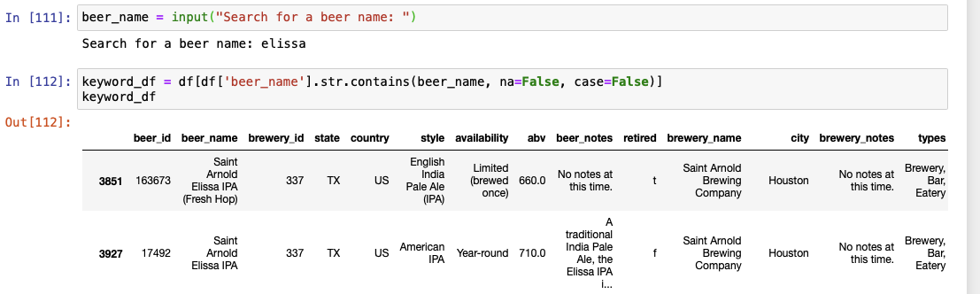
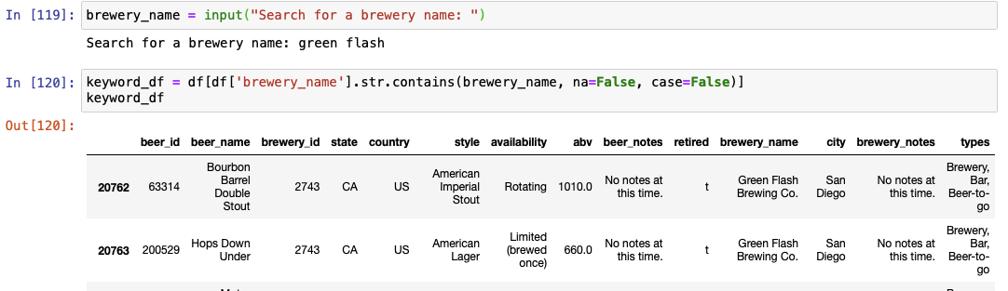
Search By Beer Name or Brewery
What beer/brewery name would you like to search for?

Slide 13
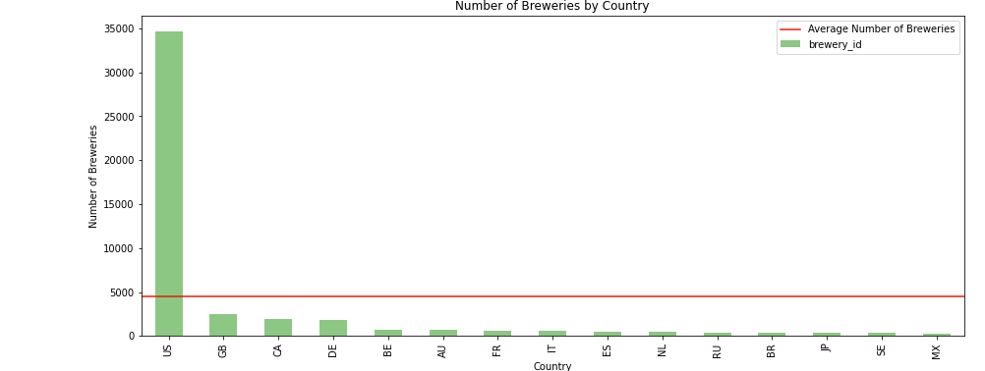
Brewery Bar Plot By Country

Slide 14
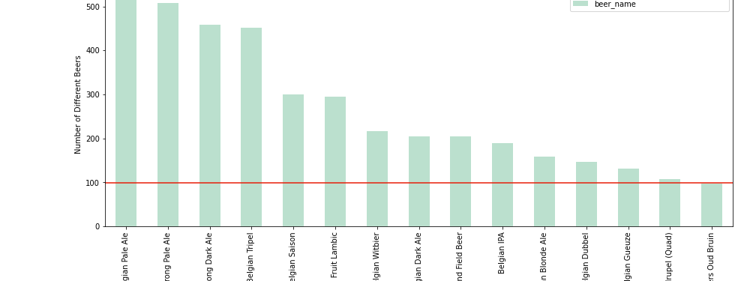
Most Beer Style for Belgium

Slide 15
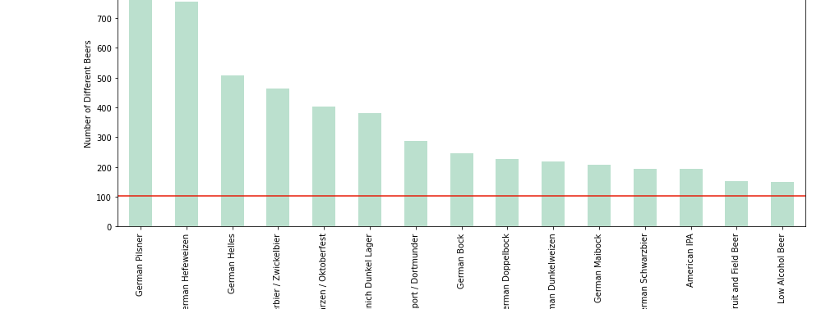
Most Beer Style for Germany

Slide 16
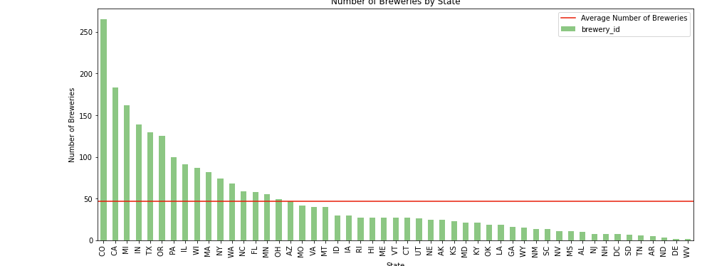
Number of Breweries By US States - 2019

Slide 17
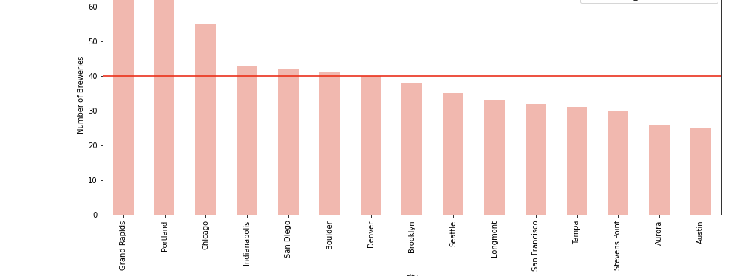
US Cities With Most Breweries

Slide 18
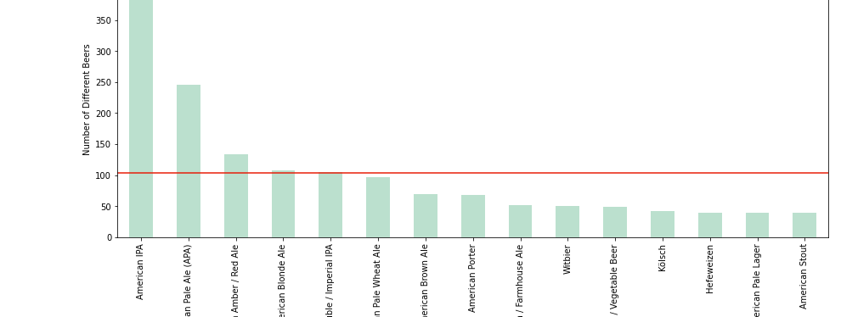
Most Brewed Beer Style

Slide 19
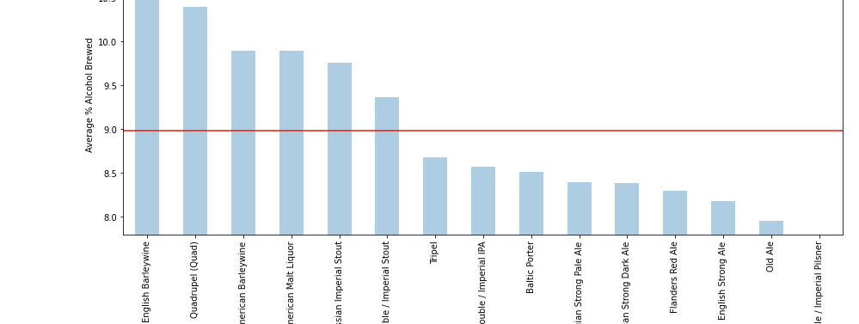
Beer with Highest ABV

Slide 20
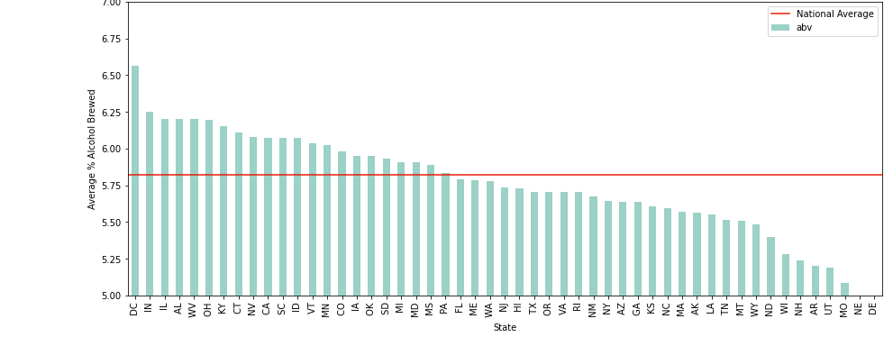
Alcohol Volume By US State

Slide 21
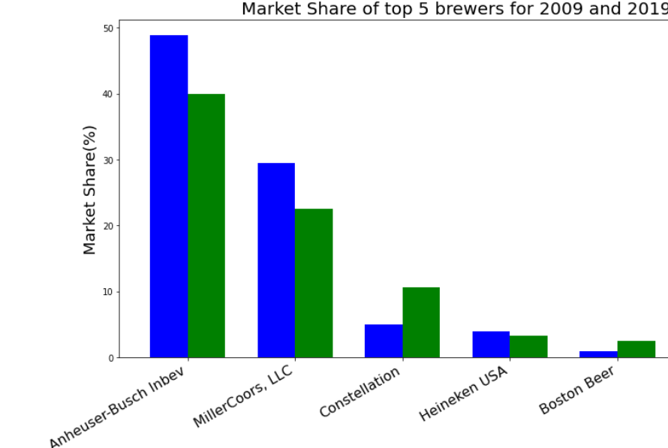
Market Share of Top 5 US Brewers

Slide 22
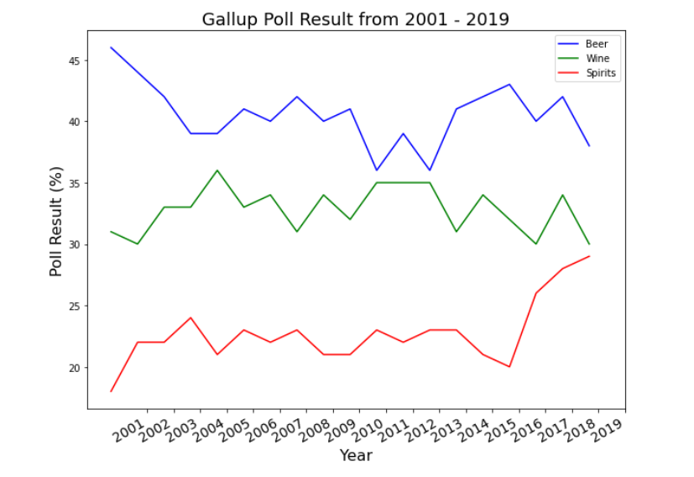
Market Share of Top 5 US Brewers

